Slide 1
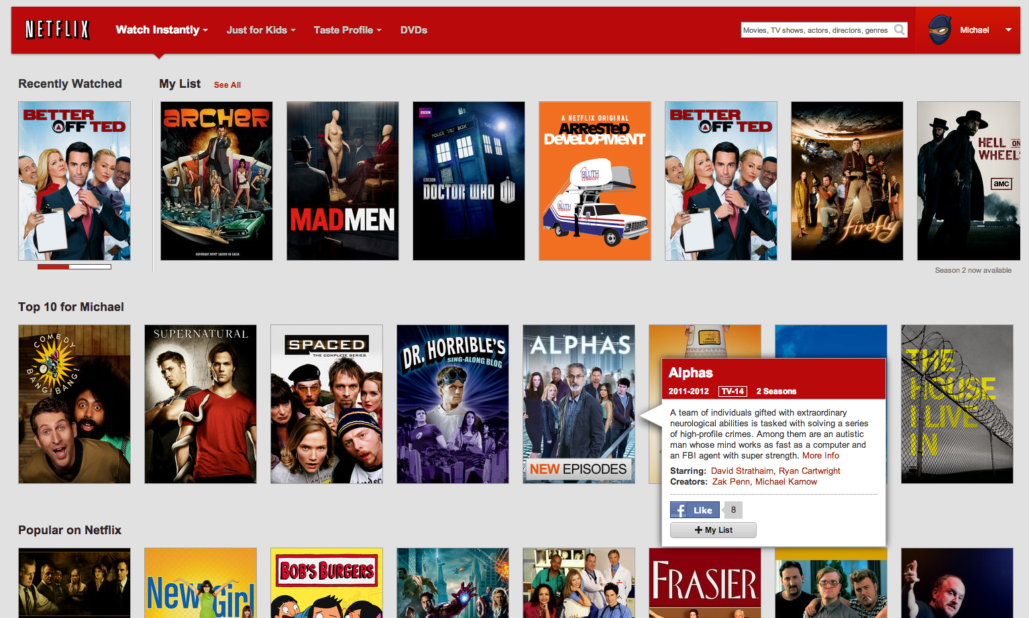
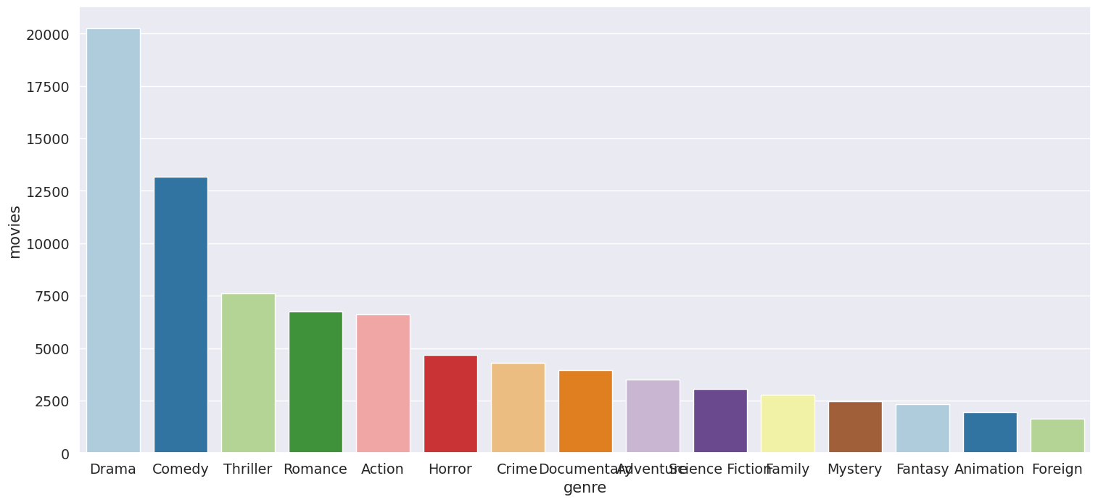
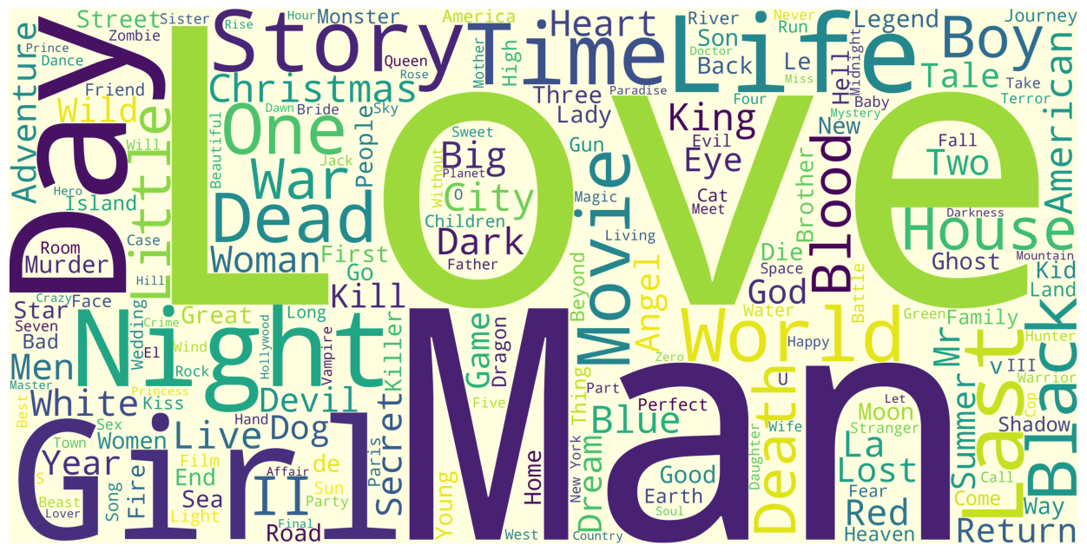
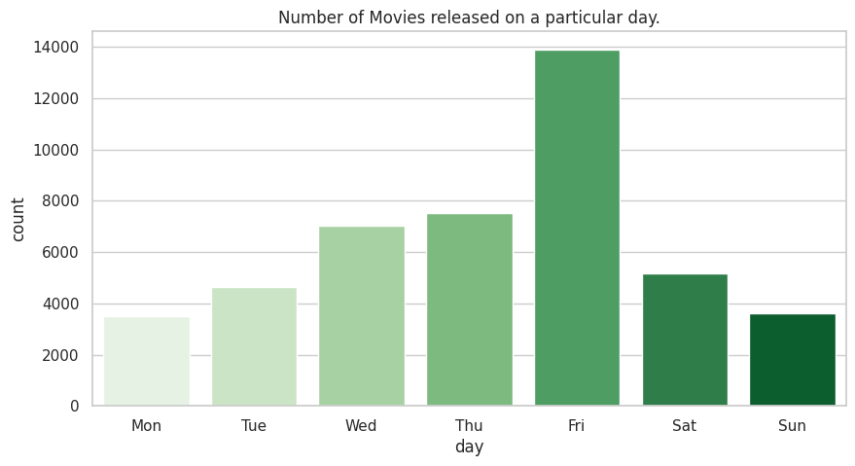
Movie Recommendation Systems - EDA – By: Avisek Regmi
“Drama” half of all movies made fall into this genres
"Love" stands out as the most frequently used word, in cinema
“Friday" most popular day for movie releases

Slide 2
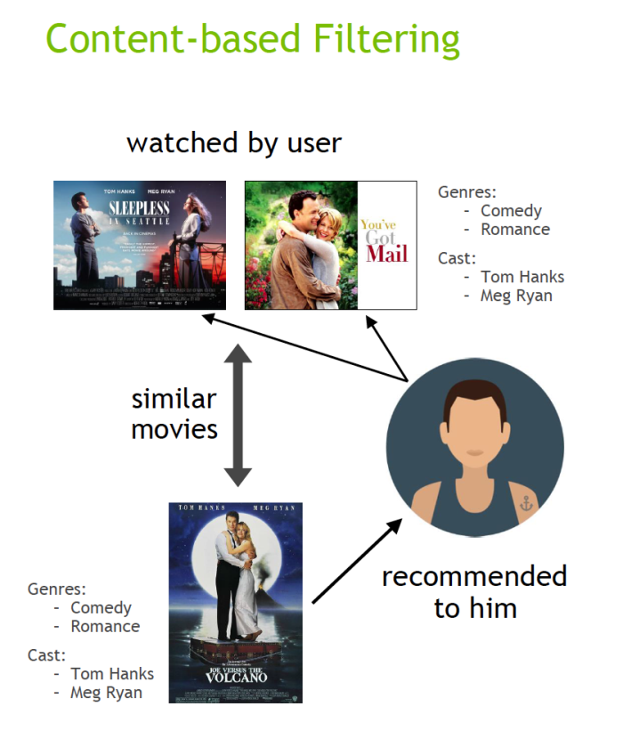
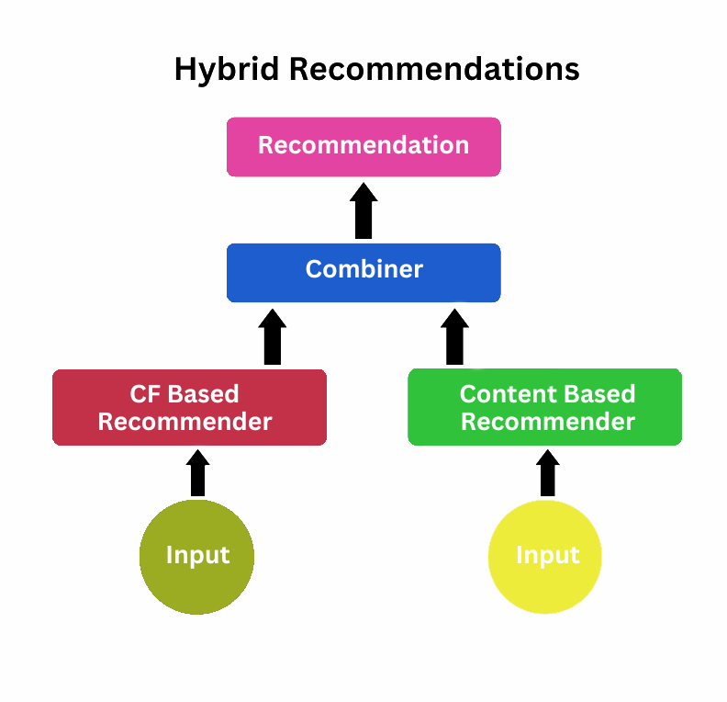
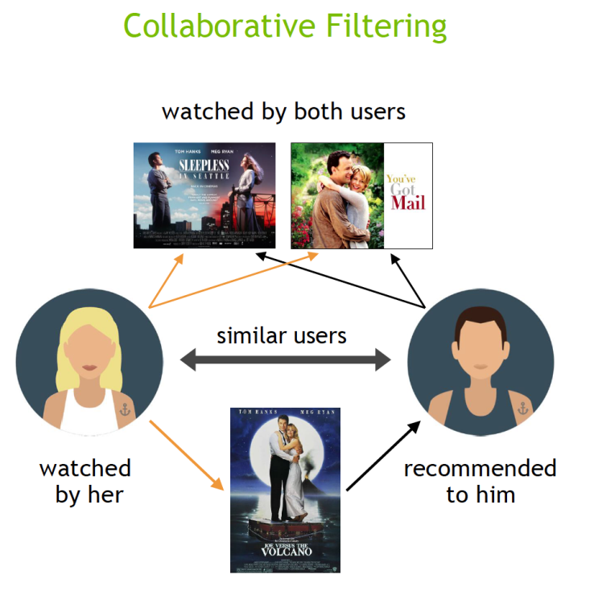
3 - Movie Recommendation Systems - By: Avisek Regmi
1. Content-based Filtering
3. Hybrid Recommendation Systems
2. Collaborative Filtering
4. Collaborative Filtering
This system takes into account two things: What You Like: It knows you're a big fan of action movies, especially ones with Tom Cruise. What Others Like: It also looks at what other users who share your taste enjoy. So, based on your love for action and Tom Cruise, it might recommend "Mission: Impossible " But because it's a hybrid system, it might also notice that your friend, who shares your taste, recently enjoyed watching a comedy called "The Hangover." So, it might throw that recommendation into the mix too, knowing you trust your friend's taste.
This system suggests movies based on similar users' preferences; for instance, if User A and User B both enjoy action movies, and User A likes a comedy, it might recommend that comedy to User B due to their shared tastes.
This system suggests movies by analyzing attributes like genre, actors, and plot keywords of previously liked movies; for example, if a user enjoyed action films with Tom Cruise, it recommends similar action movies starring him.

